Slide 1
Predicting dementia progression using machine learning on longitudinal MRI data
Yosra Hashim

Slide 2
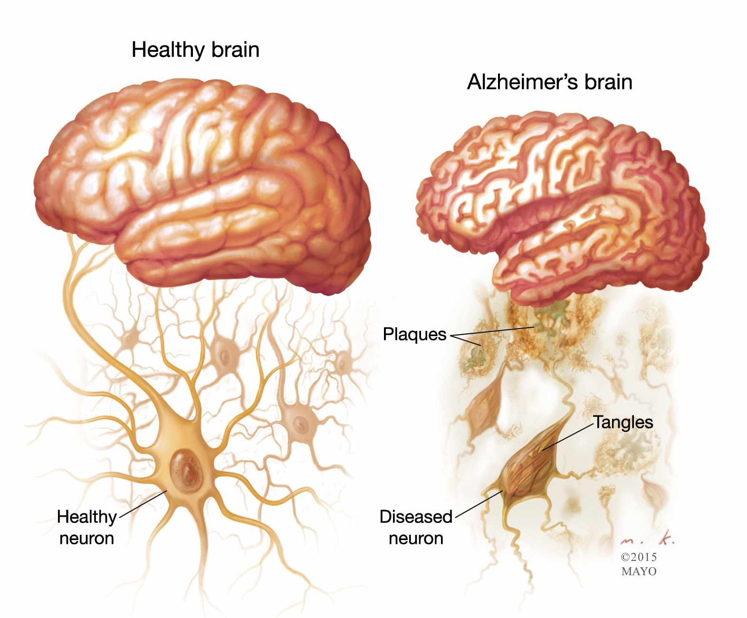
Background
Dementia is a group of diseases that results in cognitive decline. More than 55 million people have dementia worldwide and it is more common in elderly.¹ Early detection allows timely treatment which improves outcomes and quality of life.²
https://www.pyroenergen.net/wp-content/uploads/2016/04/Alzheimers-001-1.jpg

Slide 3
Main question
Can we develop a machine learning model that predicts the progression of dementia using longitudinal MRI data?

Slide 4
Data
Dataset: Open Access Series of Imaging Studies (OASIS), Longitudinal MRI Data in Nondemented and Demented Older Adults
This dataset has 150 subjects with visits separated by at least 1 year. The majority of subjects saw no change throughout the study, whereas a small group started nondemented and developed dementia by the end of the study.³

Slide 5
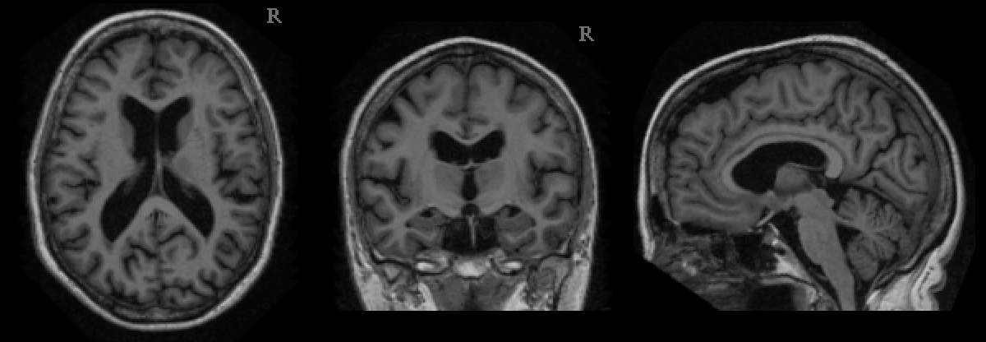
Tools and methods
Language: Python, Libraries: scikit-learn for machine learning, matplotlib for plots, nilearn for brain imaging visualization
Methods:
Preprocess
Features?
Machine learning
1. Train model
2. Validate model
OASIS MRI data

Slide 6
Objectives
Develop a machine learning model to predict dementia onset
Identify early biomarkers from T1-weighted MRI scans
Enhance understanding of neurodegenerative patterns in dementia

Slide 7
Deliverables
Github repository
Brief report publication and/or presentation

Slide 8
References
World Health Organisation. Dementia [Internet]. World Health Organization. 2023. Available from: https://www.who.int/news-room/fact-sheets/detail/dementia
The 10 benefits of early diagnosis [Internet]. Alzheimer Society of Canada. Available from: https://alzheimer.ca/en/about-dementia/do-i-have-dementia/how-get-tested-dementia-tips-individuals-families-friends/10
OASIS-2 [Internet]. Open Access Series of Imaging Studies (OASIS). 2024 [cited 2024 May 30]. Available from: https://sites.wustl.edu/oasisbrains/home/oasis-2/

